Slide 1
Lab Combustion

Slide 2
Lab combustion needed info
Video Lab combustion explanation
Lab Combustion report worksheet

Slide 3
Balance this Combustion reaction in report
C₂₅H₅₂ + O₂ → CO₂ + H₂O

Slide 4
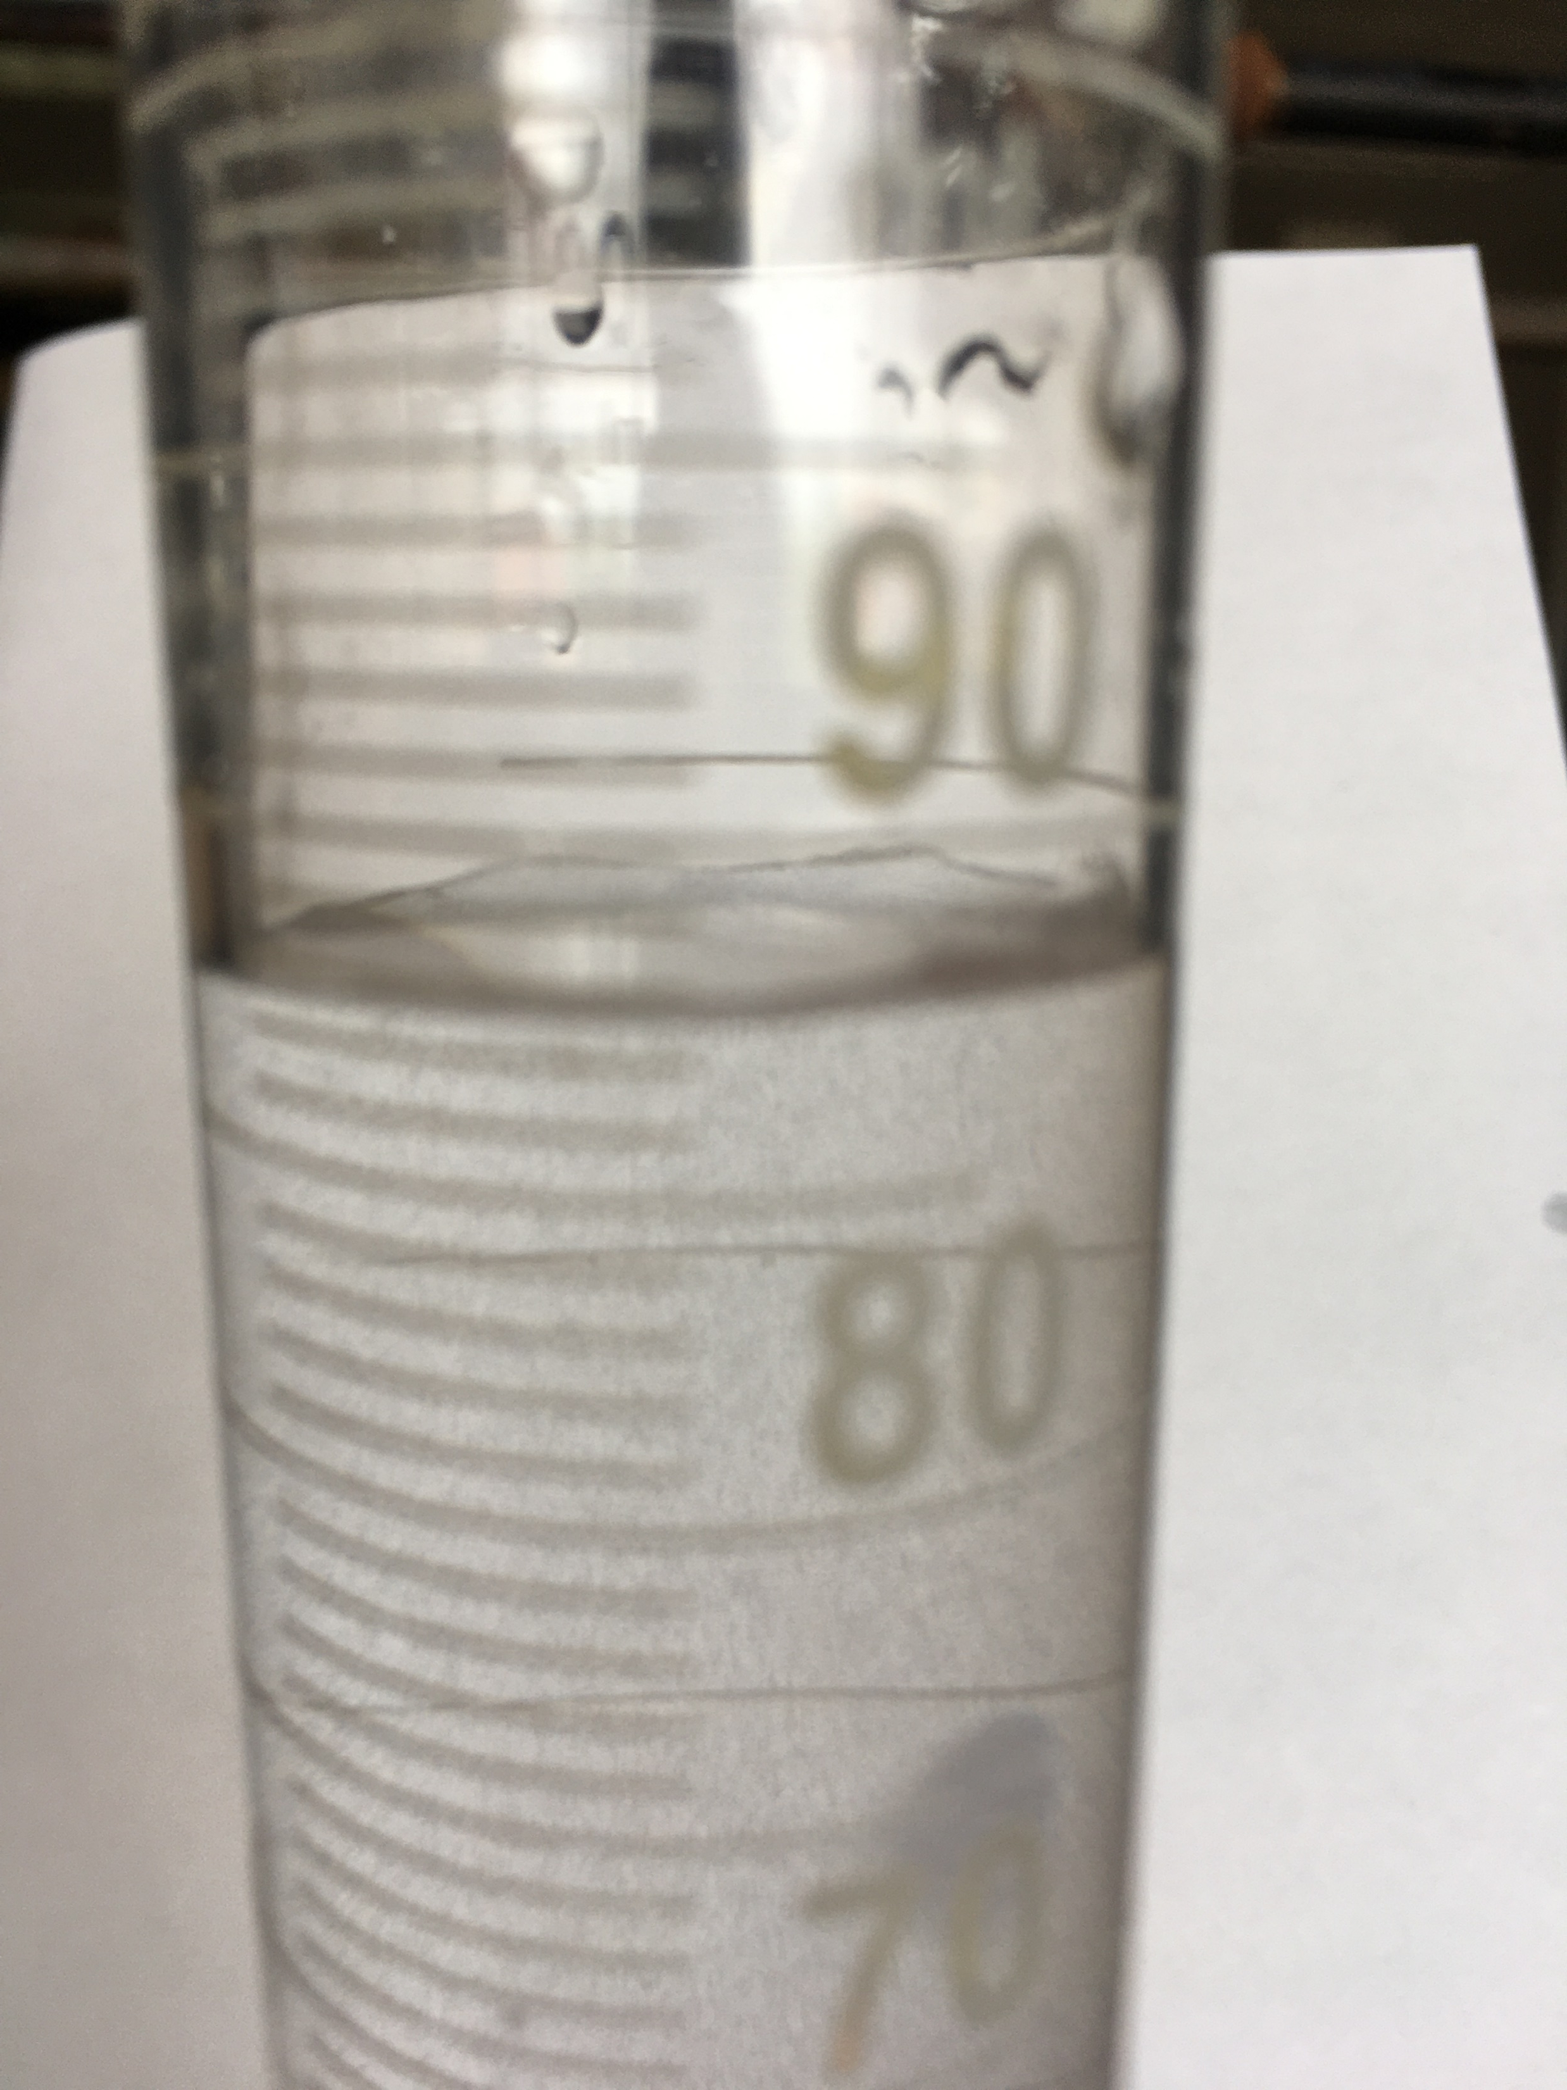
Record volume of water used. Remember to measure correctly

Slide 5
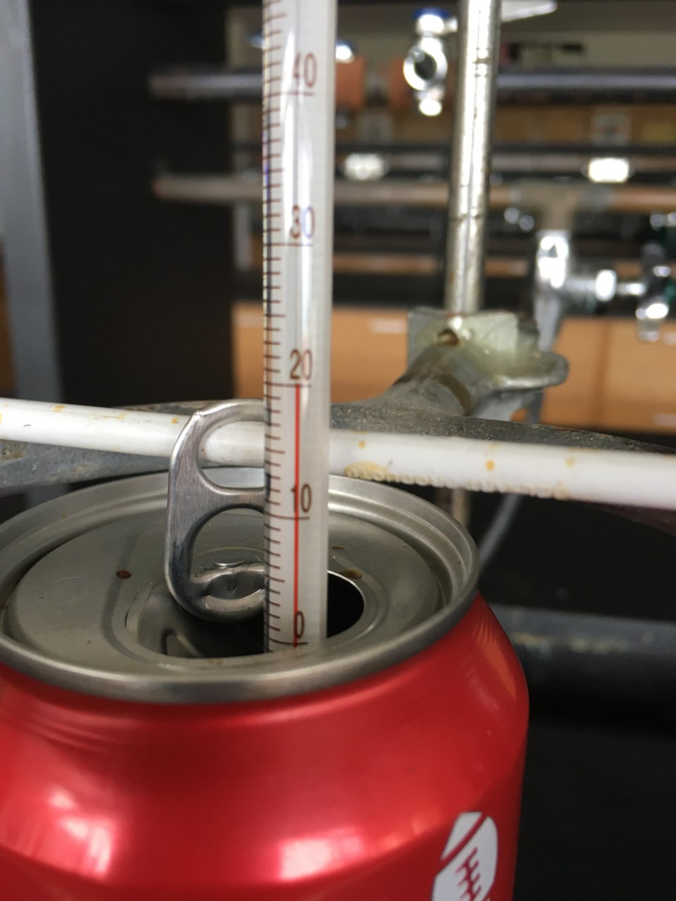
Record temperature of water. Measure correctly

Slide 6
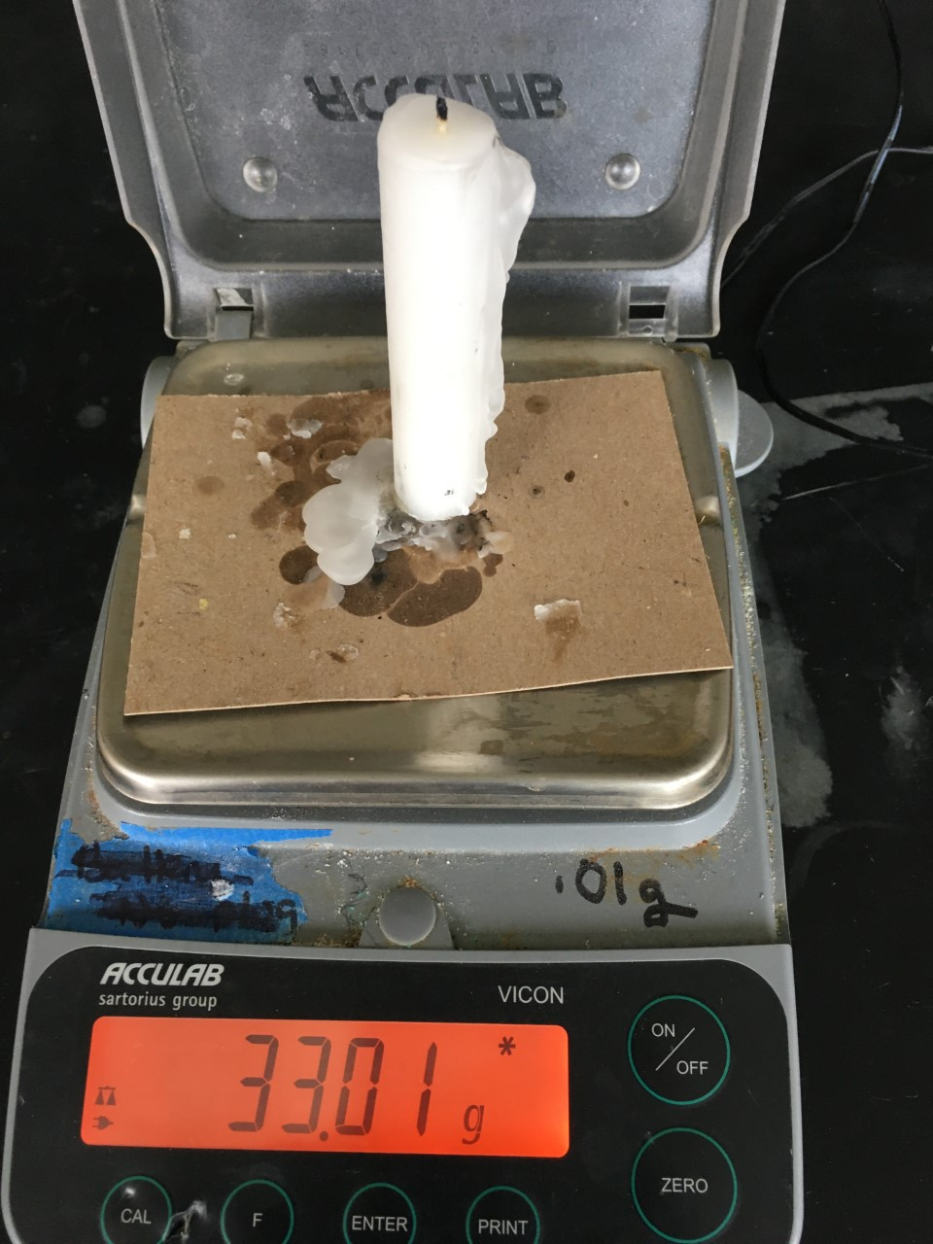
Candle and card before combusting
Record measurement correctly

Slide 7
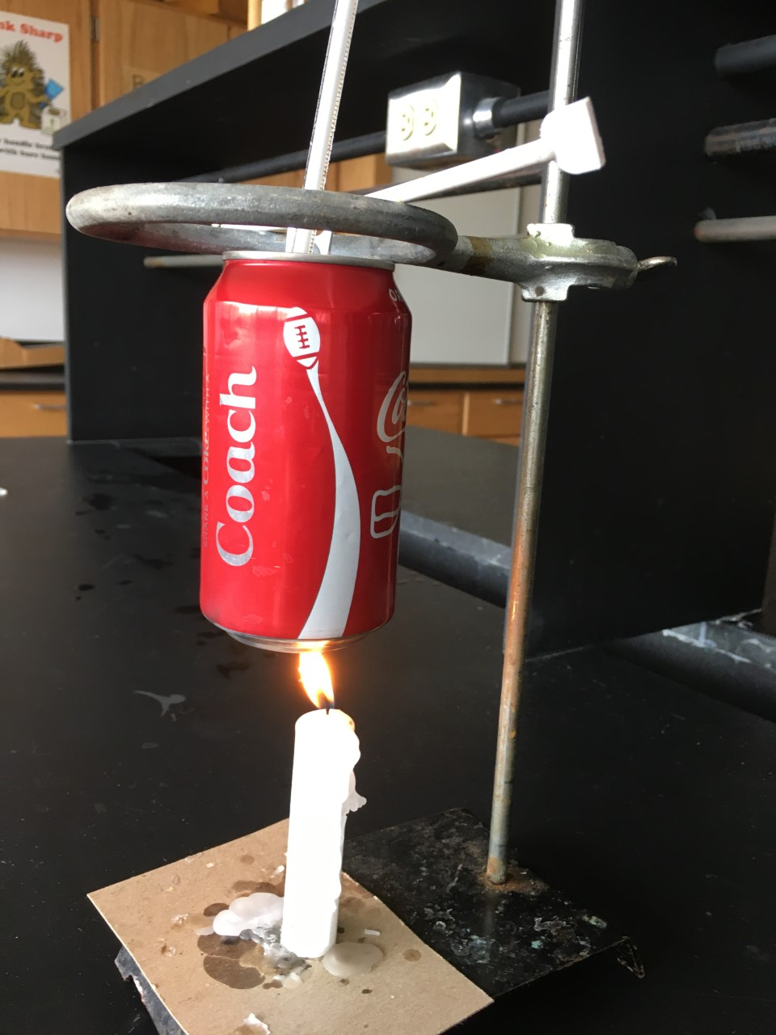
Combustion set up

Slide 8
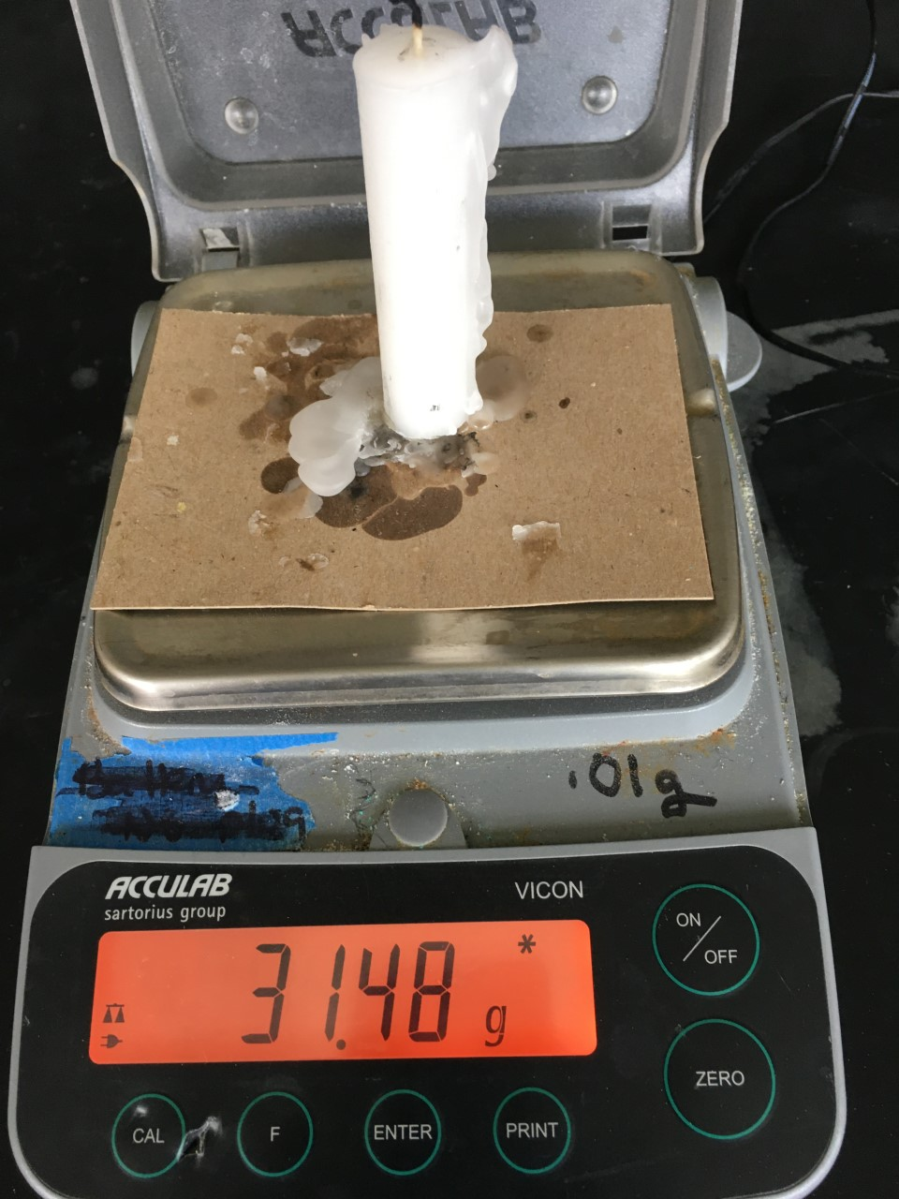
Candle and card after combustion
Record measurement correctly

Slide 9
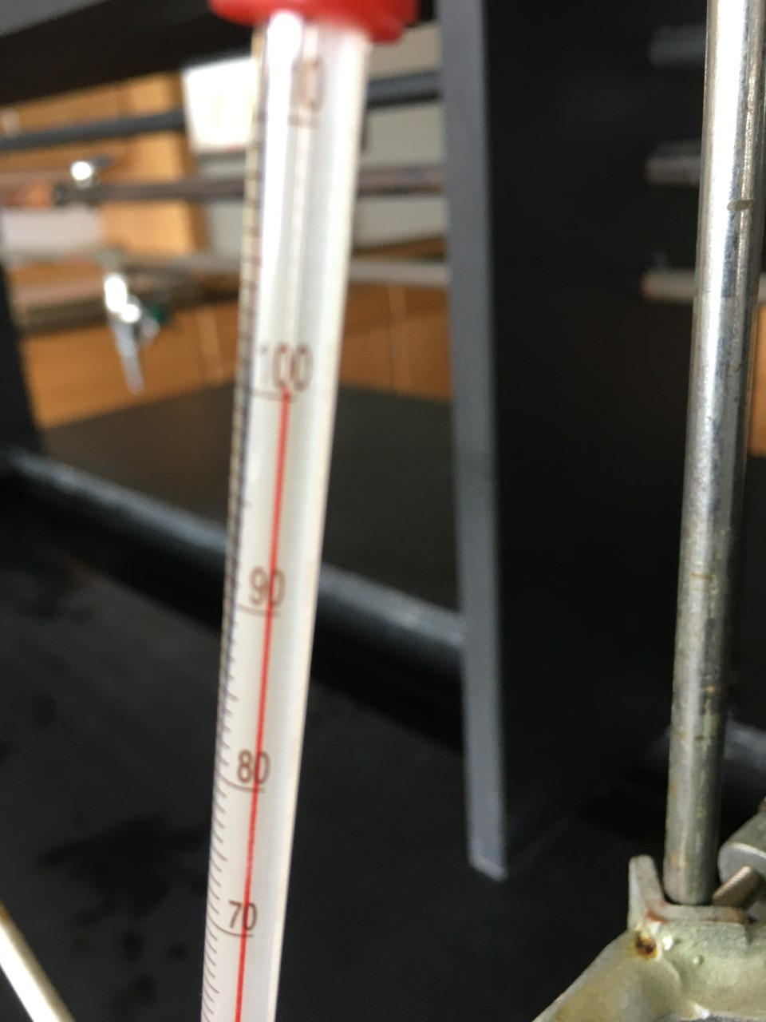
Temperature of water after combustion
Record measurement correctly

Slide 10
#1 Calculation- mass of water
#Using the volume of water in mL, convert to grams using the density of water as 1.00 g/mL. Remember sig. fig.

Slide 11
#2 calculation – heat of the water
Calculate the heat of the water
H = m x C x ∆T

Slide 12
#3 calculation- heat of the reaction
Heat heat water = heat of combustion reaction

Slide 13
#4 Calculation- moles of wax
Using g of wax burned , and molar mass of wax

Slide 14
#5 Calculation - the heat of reaction
Heat reaction = #3/#4

Slide 15
#6 include the heat of reaction into the combustion reaction.
Write the balanced chemical reaction with the heat on the appropriate side (is it endothermic or exothermic?)

Slide 16
#1 Questions – heat of different reaction
Use #5 heat and do energy stoichiometry from 15.8 g of wax

Slide 17
#2 Question
Draw energy diagram Is it endothermic or exothermic? Show the Heat of reaction in drawing.

Slide 18
#3 Question
Think! Observe phases and number of moles before and after reaction

